Slide 1

EMAIL VALIDATION

Slide 2

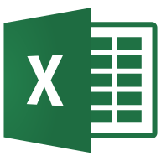



Technologies/Tools Used

Slide 3
PROBLEM STATEMENT
To validate whether accounts created on the CarePass Website consists of authentic email address
If valid email id provide the access/promotional offers
If invalid emails deny access/promotional offers

Slide 4
Approach
Read the input file which consist of email id and send a system generated *do not reply* email to the email accounts
Emails will be successfully sent to accounts which are authentic and are considered as valid email ids
For invalid email ids, email won’t be sent and we will get a response back in our mailbox as “Mail delivery Failed”
Accordingly we can flag the email ids as invalid in the input file

Slide 5
Process Work Flowow
Read email id from excel/csv input file
Send a system generated *do not reply* email to the email ids using python script send_mail.py or using Automation Anywhere Send Email command
Read emails from the system which failed delivery using python script
read_emails.py and fetch the email ids and export to new csv file
Loop through the new csv file to lookup for email ids in the input excel file and flag them as invalid

Slide 6
Files/Source Code used
Input Excel/CSV File
Send_mail.py
Reading_emails.py
Email_validation.atmx

Slide 7
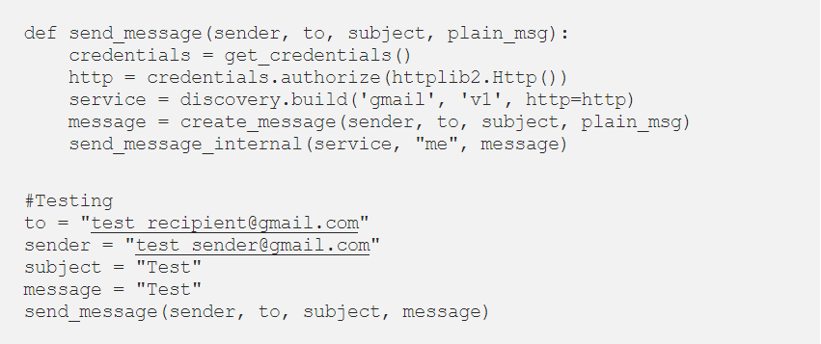
Sending Emails
The first step is to set up sending mail using Gmail API
Enable the Gmail API ‘https://developers.google.com/gmail/api/quickstart/python’ and save the file credentials.json
Run the script send_mail.py once to setup Gmail credentials in your root directory by authorizing the app to access Gmail API to send an email uncommenting the test stub with relevant mail addresses
The authorized credentials saved will be referred to by sending any mail now

Slide 8
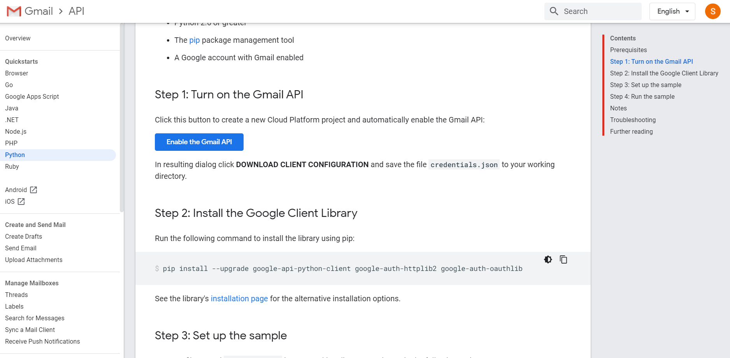
Sending Emails

Slide 9
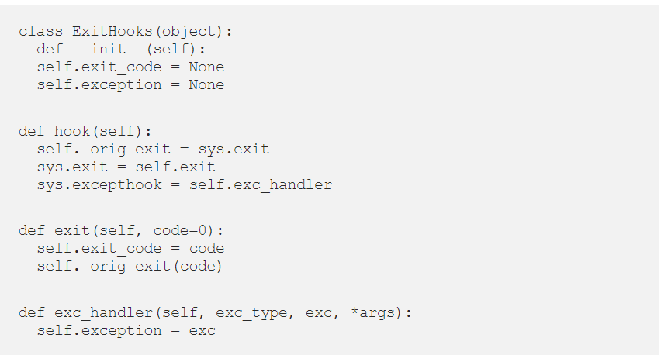
Sending Emails
The next step is to have a hook around the python sys.exit_code and sys.excepthook. For this refer to the file exit_hooks.py

Slide 10
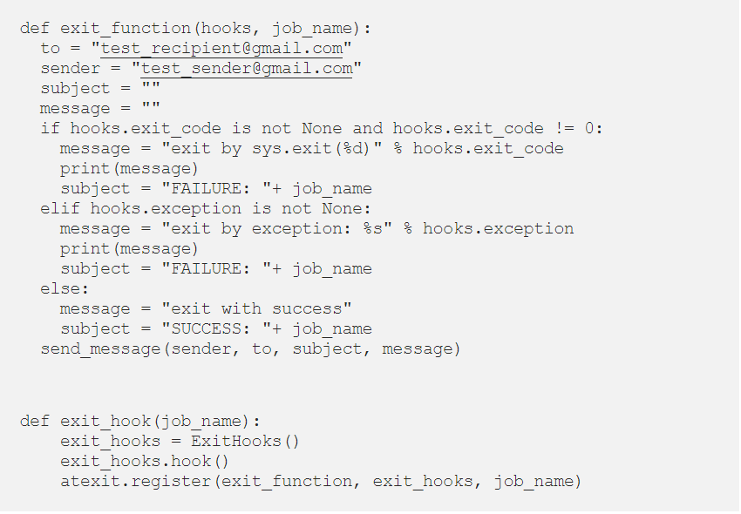
Sending Emails
In the exit_function replace the to and sender with the mail address you want to send notification from and to

Slide 11
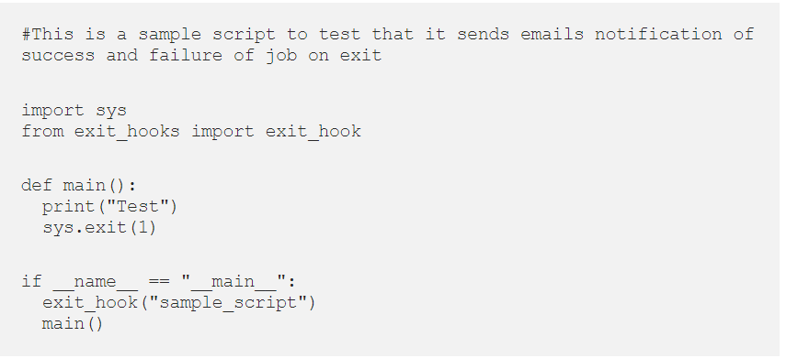
Sending Emails
The API exit_hook can now be used importing it in any python script.
exit_hookl(“sample_script”) line of code is to put at the start of any script to enable notification on success or failure exit
The above sample_script.py when run will send a failure mail notification since exit code 1 is regarded as a failure, sys.exit(0) will send a success notification

Slide 12

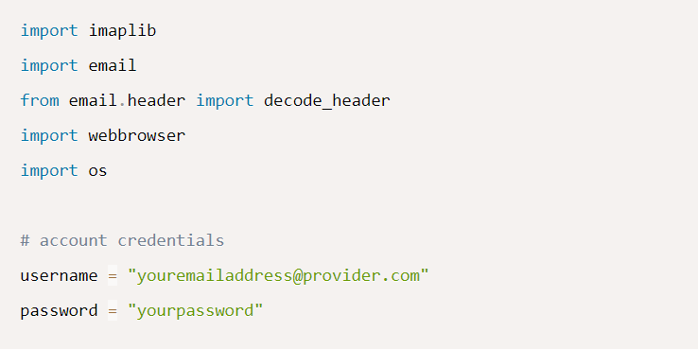
Read Emails
To get started, we don't have to install anything, all the modules used in this tutorial are the built-in ones:

Slide 13
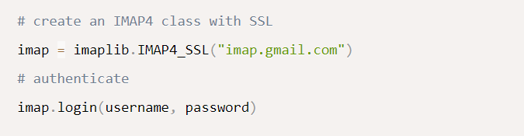
Read Emails
First, we gonna need to connect to the IMAP server:
IMAP is an Internet standard protocol used by email clients to retrieve email messages from a mail server. Unlike the POP3 protocol which downloads email and delete them from the server (and then read them offline), with IMAP, the message does not remain on the local computer, it stays on the server

Slide 14

Read Emails
Since I'm testing this on a gmail account, I've used imap.gmail.com server
Check this link that contains list of IMAP servers for most commonly used email providers
Also, if you're using a Gmail account and the above code raises an error indicating that the credentials are incorrect, make sure you allow less secure apps on your account

Slide 15
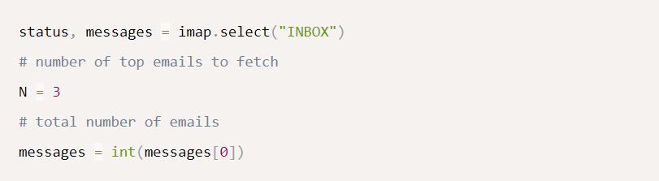
Read Emails
If everything went okey, then you have successfully logged in to your account, let's start getting emails:
We've used imap.select() method, which selects a mailbox (Inbox, spam, etc.), we've chose INBOX folder, you can use imap.list() method to see the available mailboxes
messages variable contains number of total messages in that folder (inbox folder)
status is just a message that indicates whether we received the message successfully
We then converted messages into an integer so we can make a for loop

Slide 16
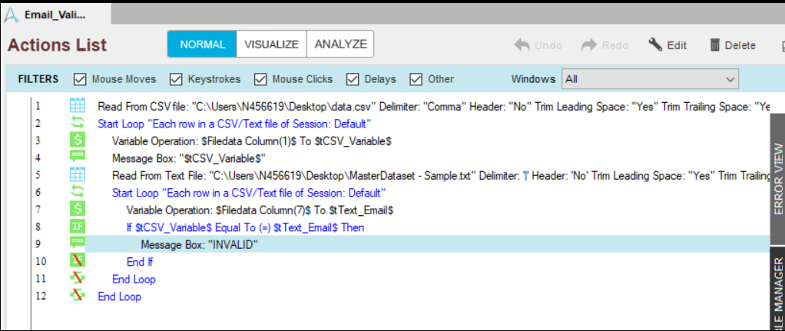
Validate Records
Use Automation Anywhere to Loop through newly created csv file and lookup for records in excel/csv input file to flag invalid emails

Slide 17
THANK YOU

